Slide 1

IBM Project Presentation on “Artificial Intelligence Based Solutions for Corporate Employees”
By
Group ID: G21
Mayan Suthar(21162172005)
Mahendrasinh Dod(21162102002)
Nawaz Bakali(20162121003)
Institute of Computer Technology, Ganpat University
Date:03/05/2024

Slide 2
Table of Contents
Introduction
Goals / Objectives
Background
Recommended Approach
Tools & Technologies
Flowchart & Algorithms
Implementation Details
Conclusion

Slide 3
Introduction
Project is designed to assist corporate employees in efficiently evaluating job applicants' resumes.
Need for AI-based solutions to automates the process of resume screening.

Slide 4
Goals / Objectives
It can be used for getting all the resume data into a structured tabular format and csv as well, so that the organization can use those data for analytics purposes.
By providing recommendations, predictions and overall score user can improve their resume and can keep on testing it on our tool.
And it can increase more traffic to our tool because of user section.
It can be used by colleges to get insight of students and their resume before placements.
Also, to get analytics for roles which users are mostly looking for.
To improve this tool by getting feedbacks.
Bot can help HR or other employee to get summarize view.
With that bot can act as Cyber Security Trainee Program.

Slide 5
Background
Feature Extraction
Model Optimization
Machine Learning (ML)
Python

Slide 6
Recommended Approach
Integration: Develop a user-friendly interface for corporate employees to upload resumes and view analysis results.
Data Collection: Gather a diverse set of resumes
Preprocessing: Clean and preprocess the resumes to remove irrelevant information
Feature Extraction: Extract relevant features such as skills, experience, education, and achievements from the resumes
Model Development: Train machine learning models
Deployment: Deploy the Resume Analyzer as a website

Slide 7
Tools & Technologies
Frontend
Streamlit
HTML
CSS
JavaScript
Backend
Streamlit
Python
Database
MySQL
Modules
pandas
pyresparser
pdfminer3
Plotly
NLTK

Slide 8
Features
Client: -
Fetching Location and Miscellaneous Data
Using Parsing Techniques to fetch
Basic Info
Skills
Keywords
Using logical programs, it will recommend
Skills that can be added
Predicted job role
Course and certificates
Resume tips and ideas
Overall Score
Interview & Resume tip videos
Feedback: -
Form filling
Rating from 1 – 5
Show overall ratings pie chart
Past user comments history

Slide 9
Features
Admin: -
Get all applicant’s data into tabular format
Download user’s data into csv file
View all saved uploaded pdf in Uploaded Resume folder
Get user feedback and ratings
Pie Charts for: -
Ratings
Predicted field / roles
Experience level
Resume score
User count
City
State
Country

Slide 10
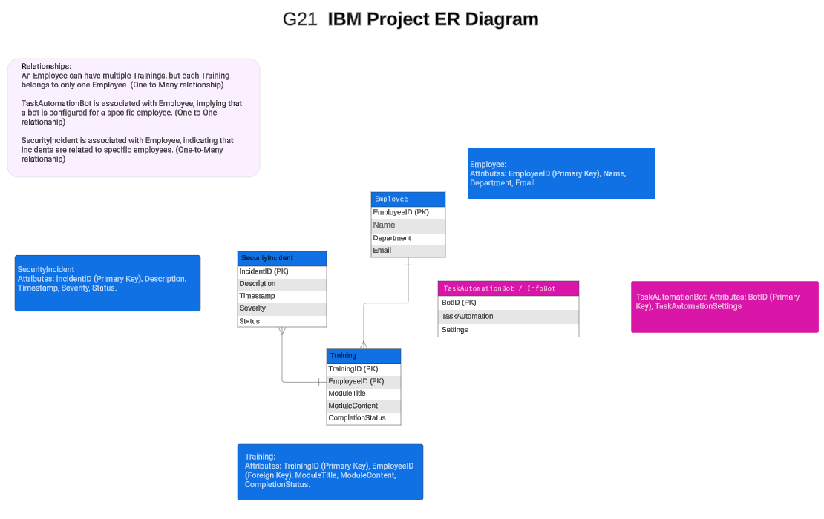
Flowchart & Algorithms
Figure 6.1: ER Diagram.

Slide 11
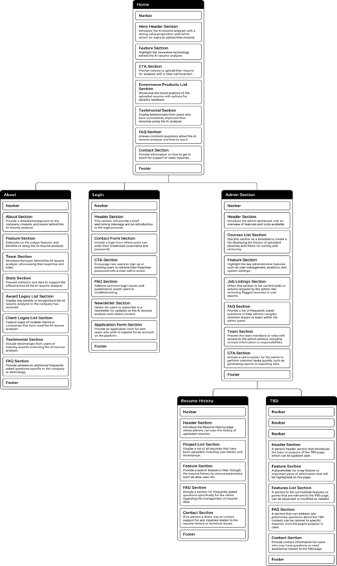
Flowchart & Algorithms
Figure 6.2: Site Map.

Slide 12
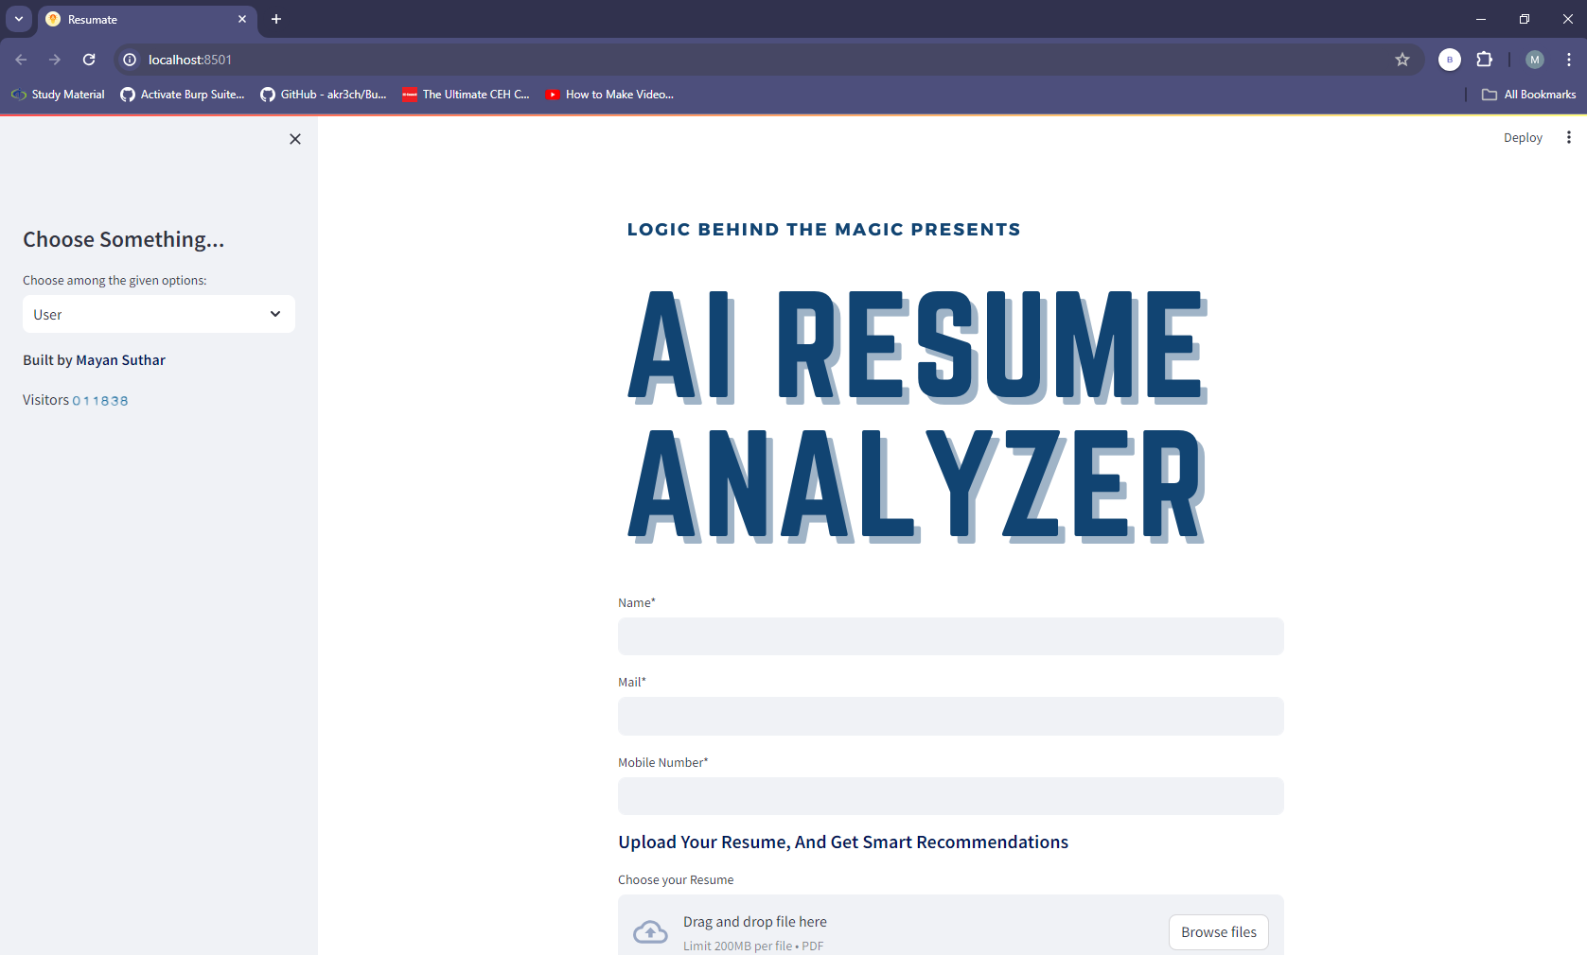
Implementation
Figure 7.1: Home Page.

Slide 13
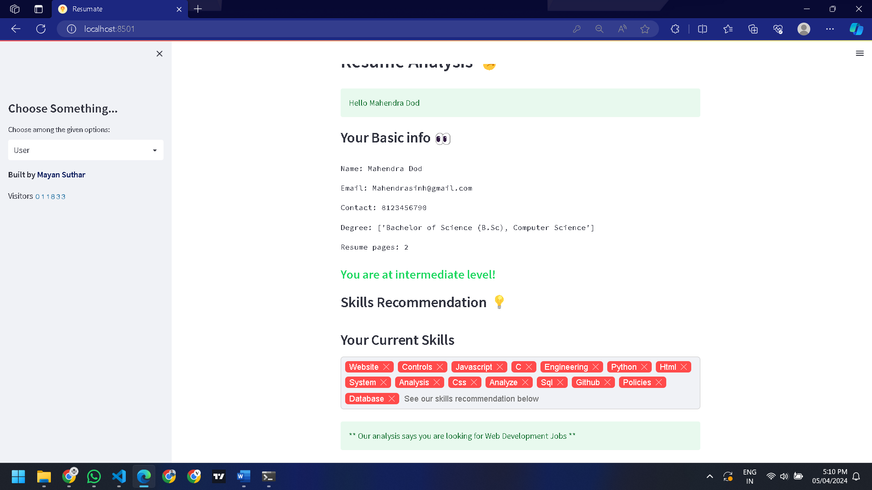
Resume Result
Figure 7.2: Parser Resume Result.

Slide 14
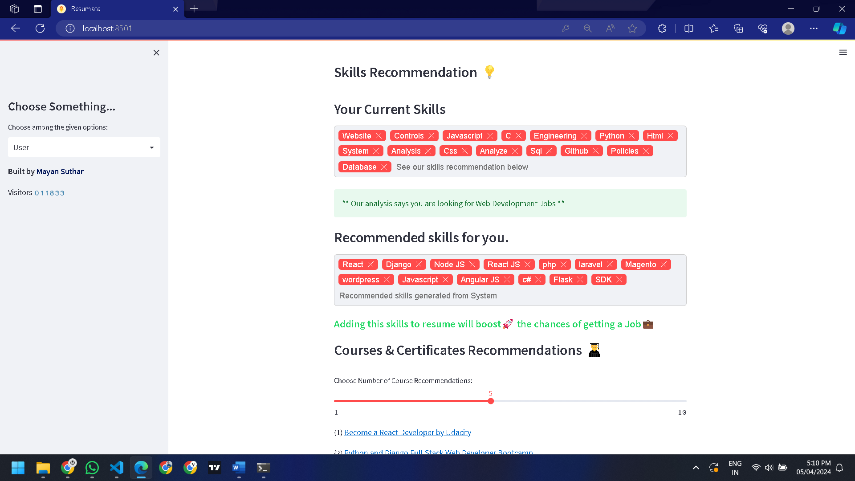
Resume Result
Figure 7.3: Parser Resume Result.

Slide 15
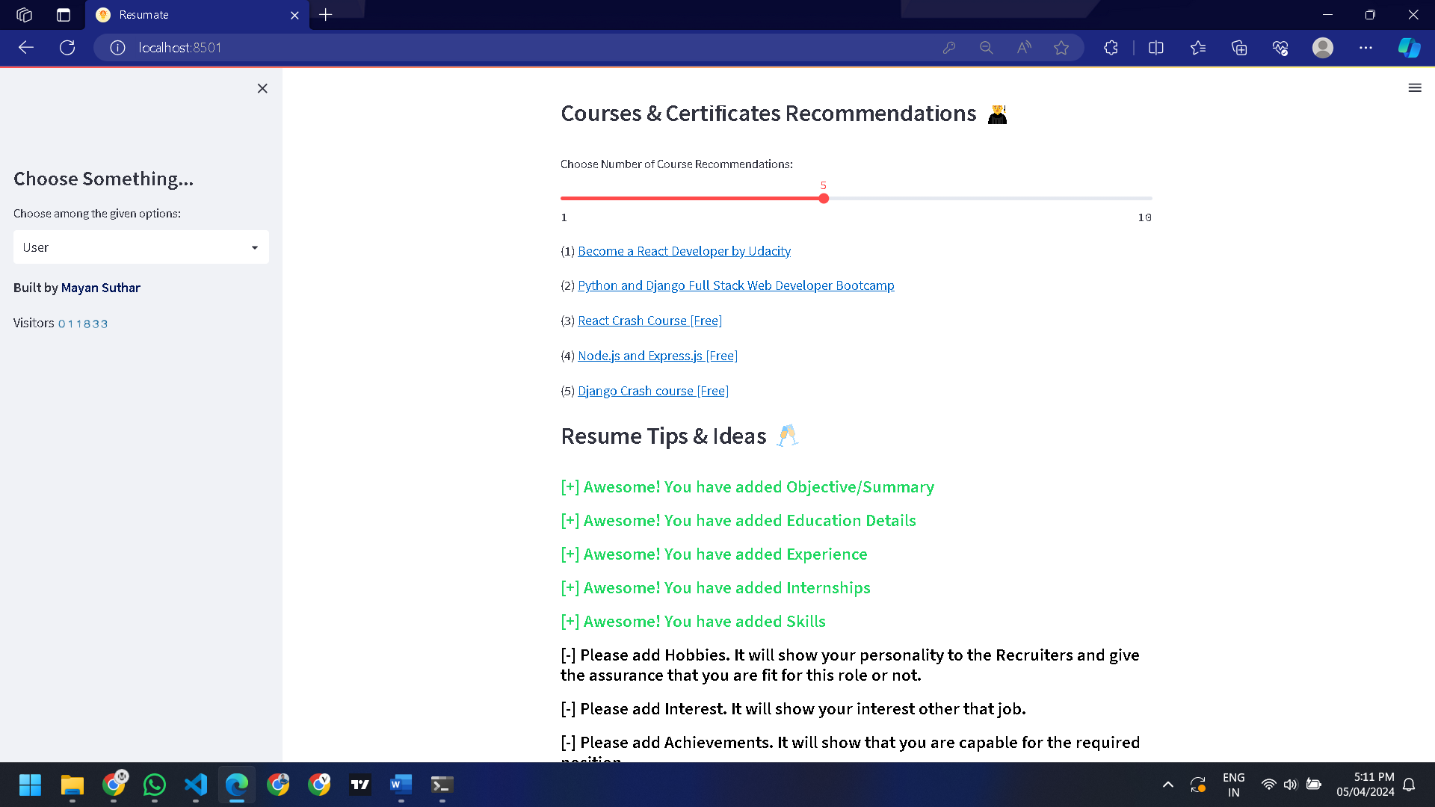
Resume Result
Figure 7.4: Parser Resume Result.

Slide 16
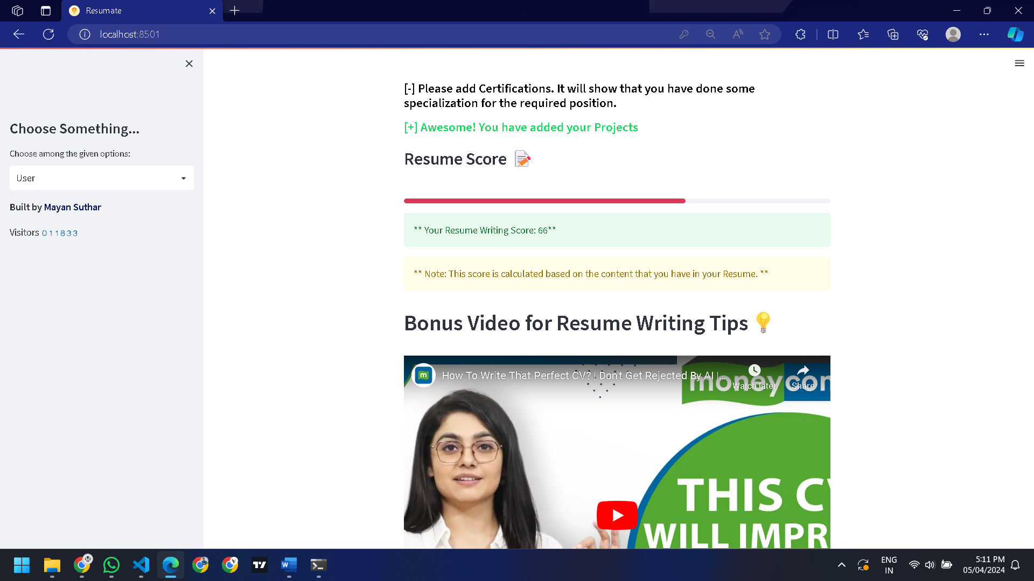
Resume Score
Figure 7.5: Parser Resume Result.

Slide 17
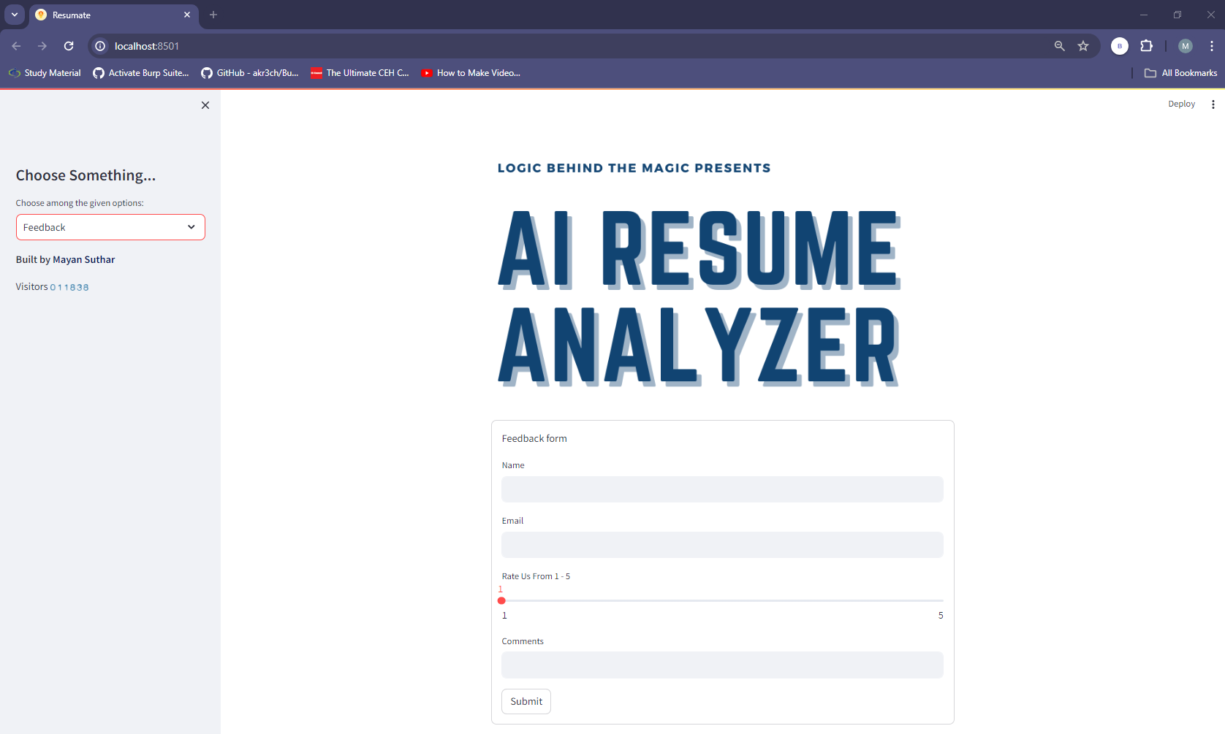
Feedback Page
Figure 7.6: Feedback Page.

Slide 18
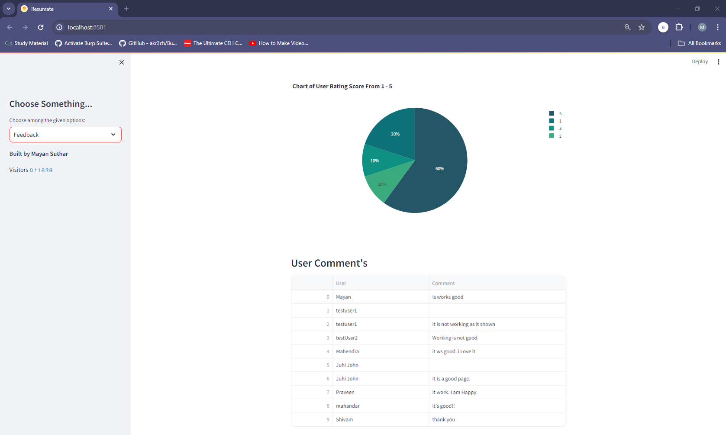
User Comments
Figure 7.7: Feedback Page - Pie Chart Summarizes of Other Users' Comments.

Slide 19
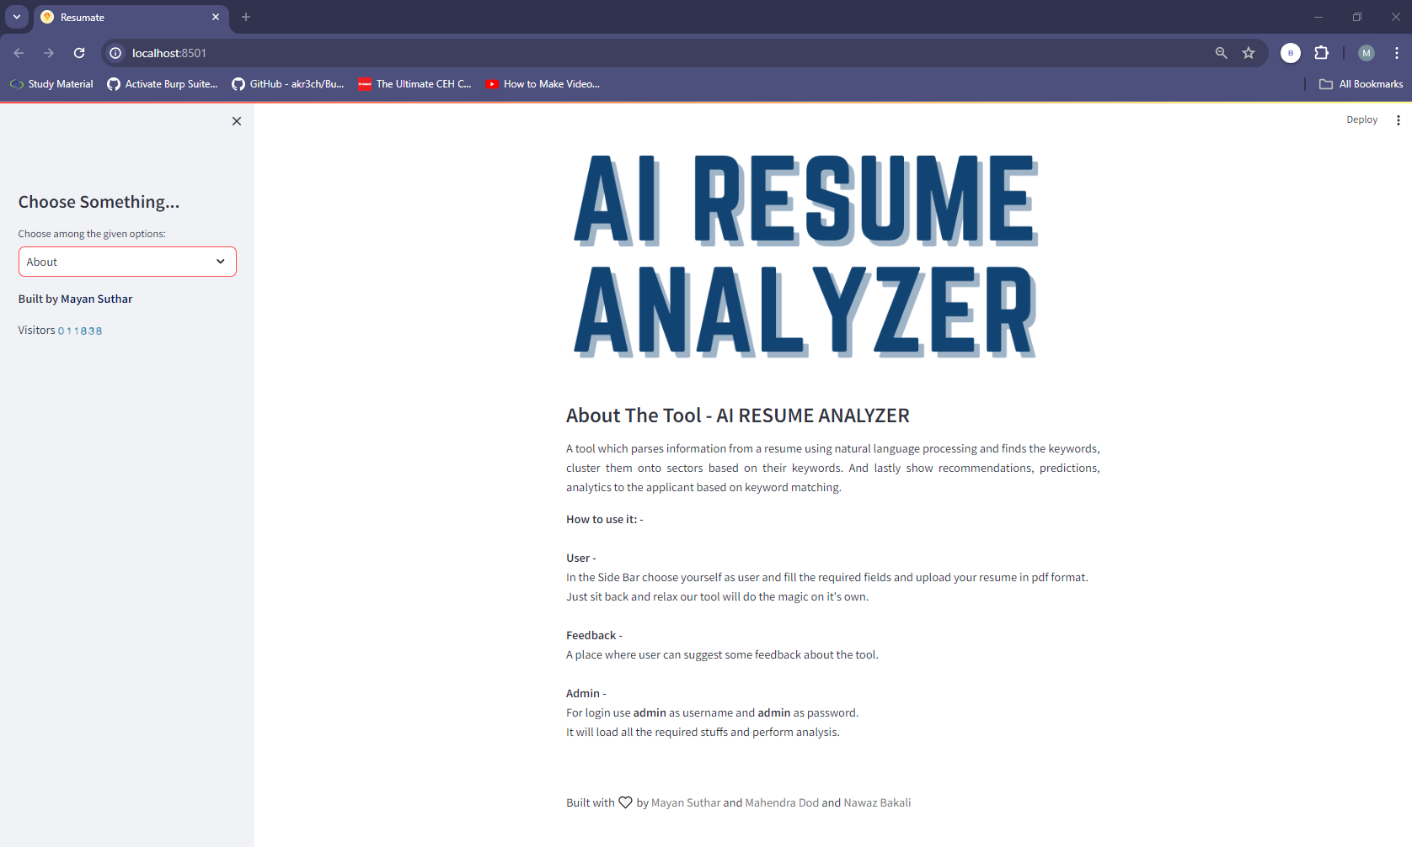
About Page
Figure 7.8: About Us Page.

Slide 20
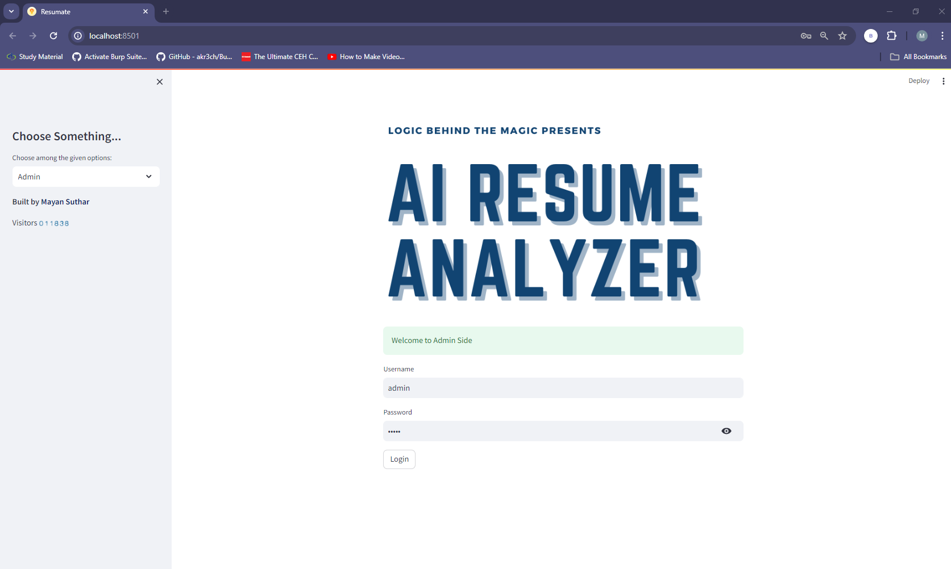
Admin Login
Figure 7.9: Admin Page.

Slide 21
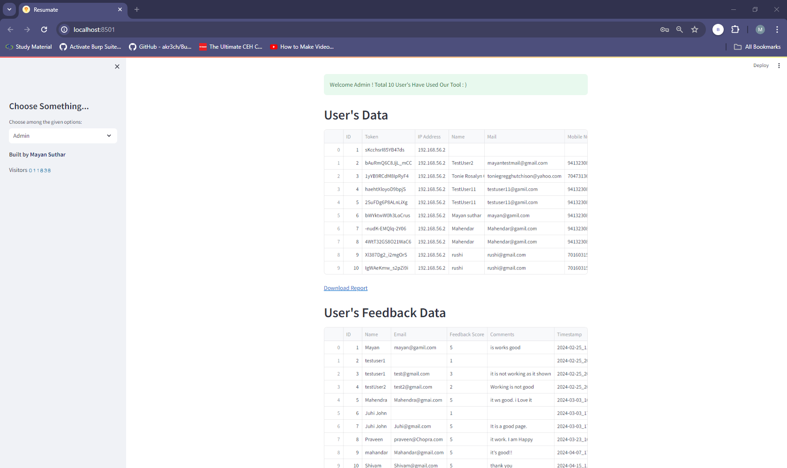
Admin Page
Figure 7.10: Admin Page - User Resume Data and Feedback Data. It also has the Download Report option on the page.

Slide 22
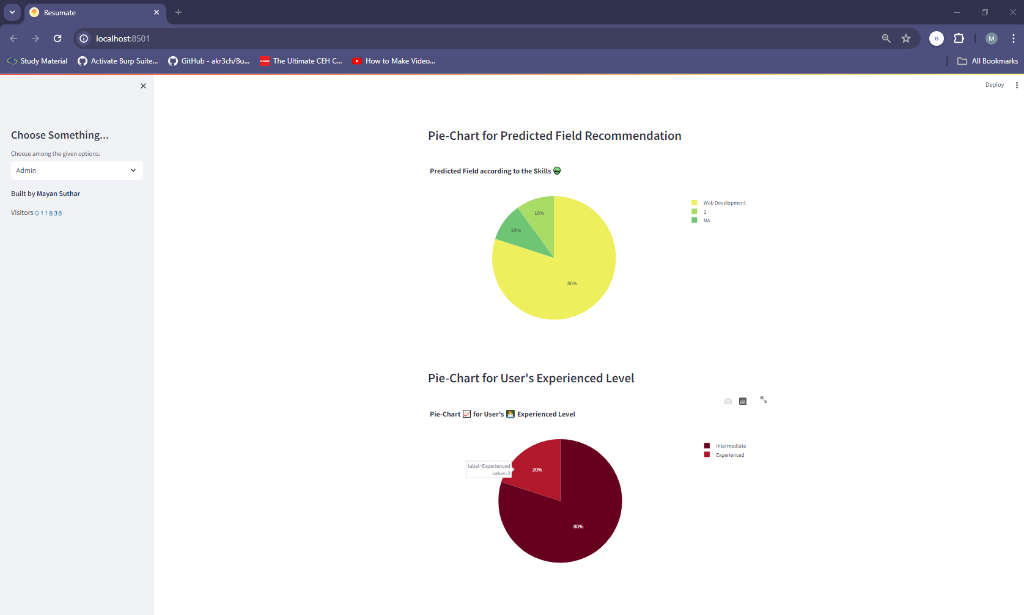
Admin Page
Figure 7.11: Admin Page - Pie-Chart for User's Experienced Level and for Predicted Field Recommendation.

Slide 23
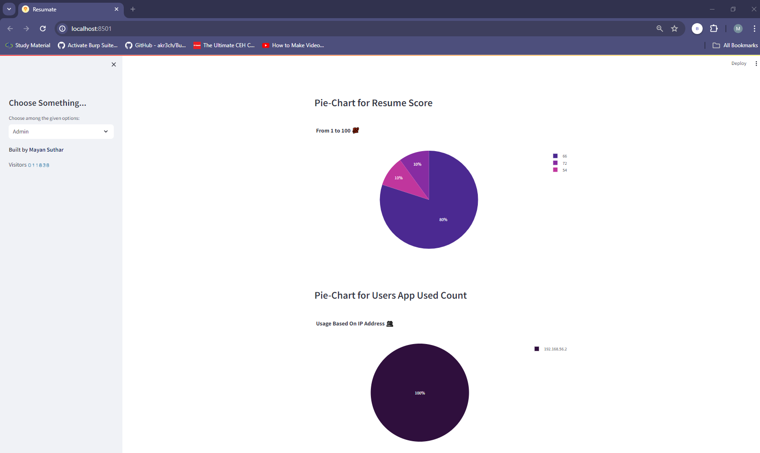
Admin Page
Figure 7.12: Admin Page - Pie-Chart for Users App Used Count and for Users App Used Count.

Slide 24
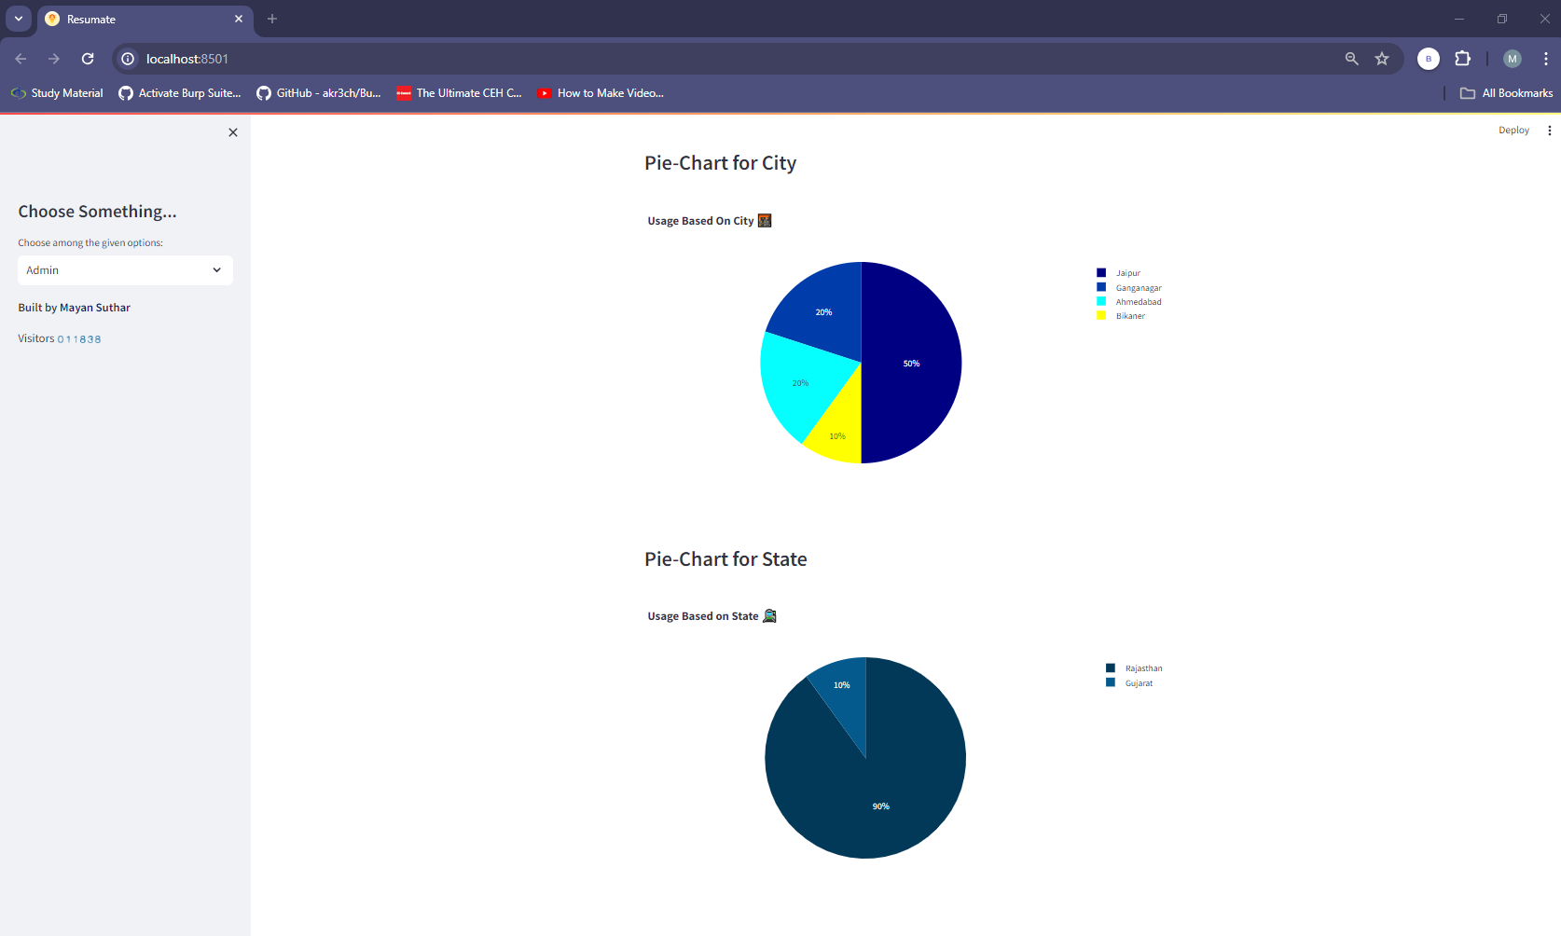
Admin Page
Figure 7.13: Admin Page - Pie-Chart for State and City.

Slide 25
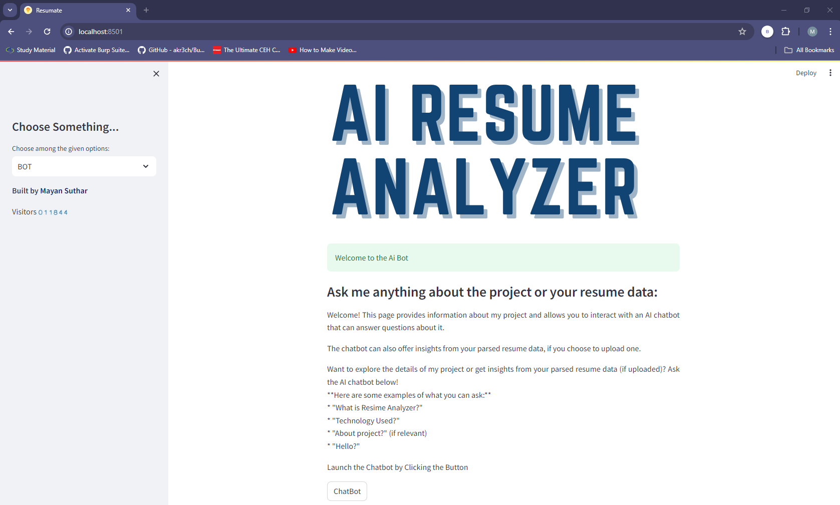
ChatBot Redirect
Figure 7.14: Chat Bot Page.

Slide 26
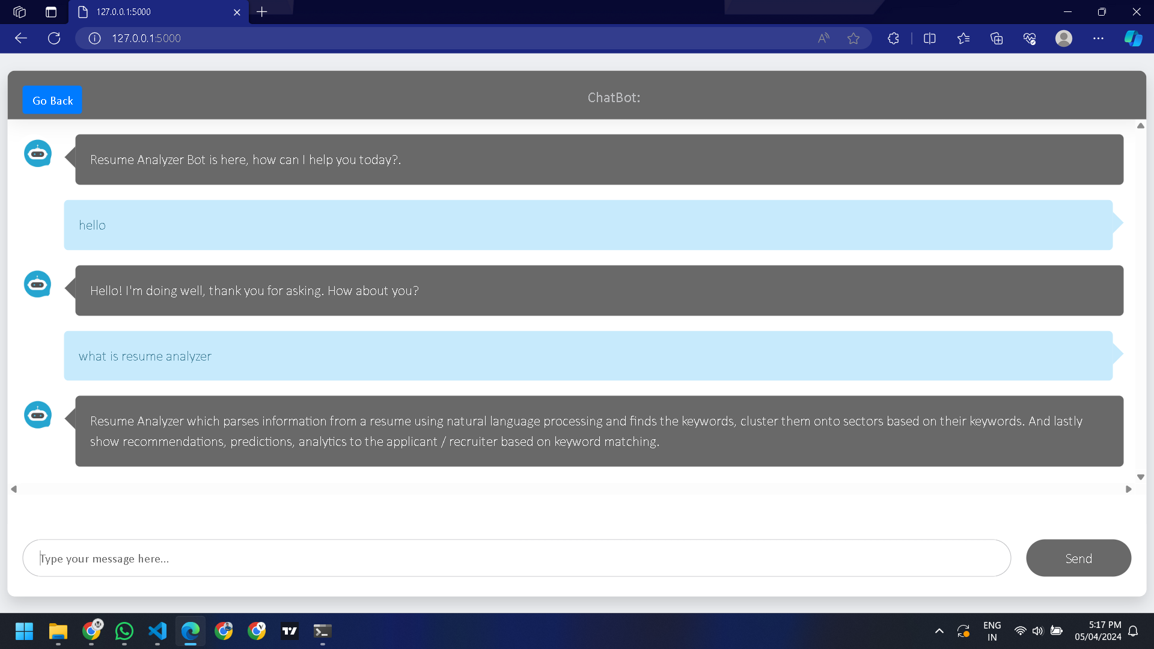
ChatBot
Figure 7.15: Chabot Page.

Slide 27
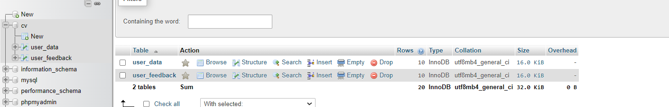
DataBase
Figure 7.16: DataBase Tables.

Slide 28
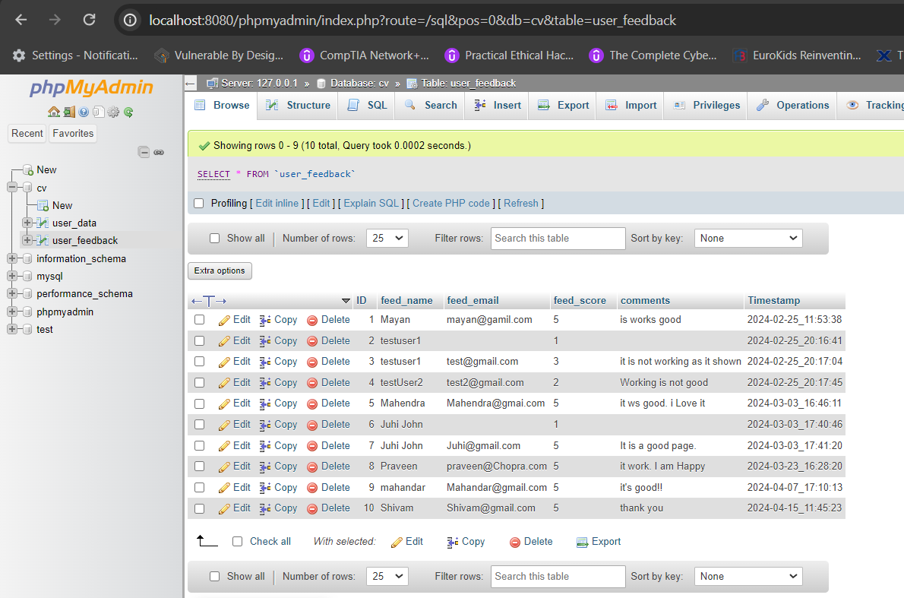
DataBase (FeedBack Data)
Figure 7.17: DataBase – user_data table (ID, feed_name, feed_email, feed_score, comments).

Slide 29
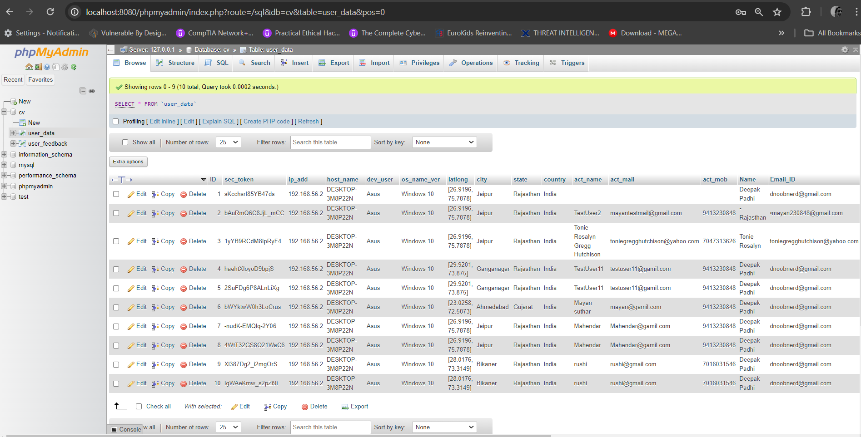
Database (User Data)
Figure 7.18: DataBase – user_feedback table (ID,sec_token,ip_add, host_name, dev_user, os_name_ver, latlong, city, state ,country, act_name, act_mail, act_mob, Name, Email_ID, resume_score, Timestamp, Page_no, Predicted_Field, User_level, Actual_skills, Recommended_skills, Recommended_courses, pdf_name).

Slide 30
Flowchart & Algorithms
Site Map: https://www.figma.com/file/xQFjFq7g2f2Yg1IO6Pkt8y/IBM---AI-Resume-Analyzer?type=design&node-id=0-1&mode=design&t=IpOPSLQAz7FOdBjG-0
ER Diagram: https://lucid.app/lucidchart/773b9ec9-7324-45eb-a1d6-070067ec19d4/edit?invitationId=inv_9ba6c9d4-8fe7-4aed-94fc-fbccfafc4ab3&page=0_0#

Slide 31
Thank You !!

